Slide 1
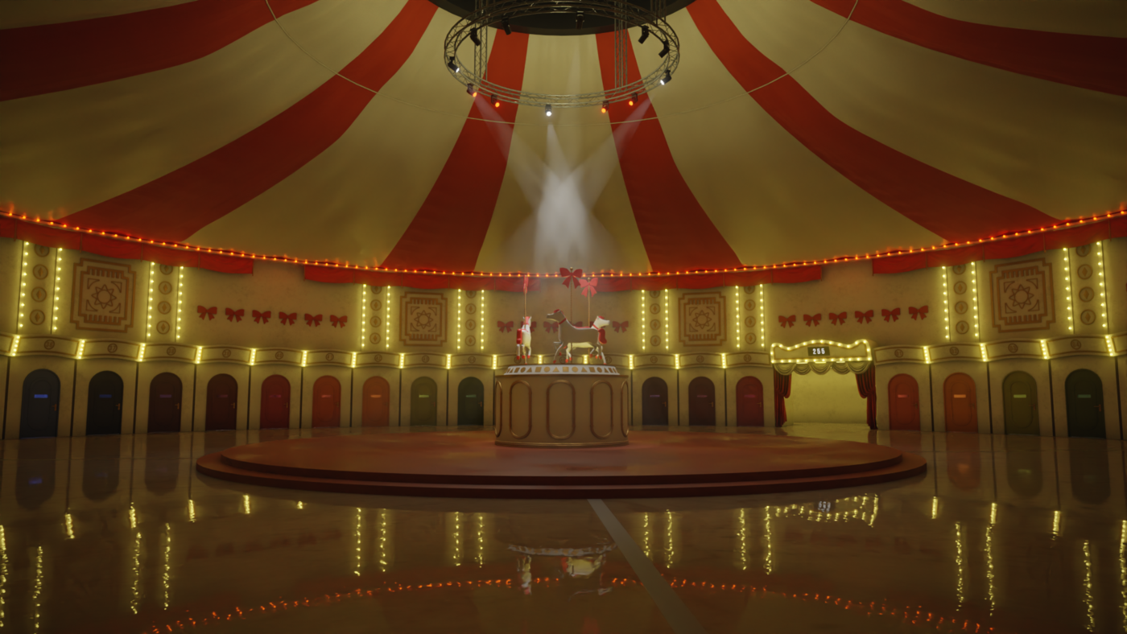

Cooperative Mingle
Kovács Imre Levente
Makó Kristóf Zsolt
Tóth Benjámin

Slide 2

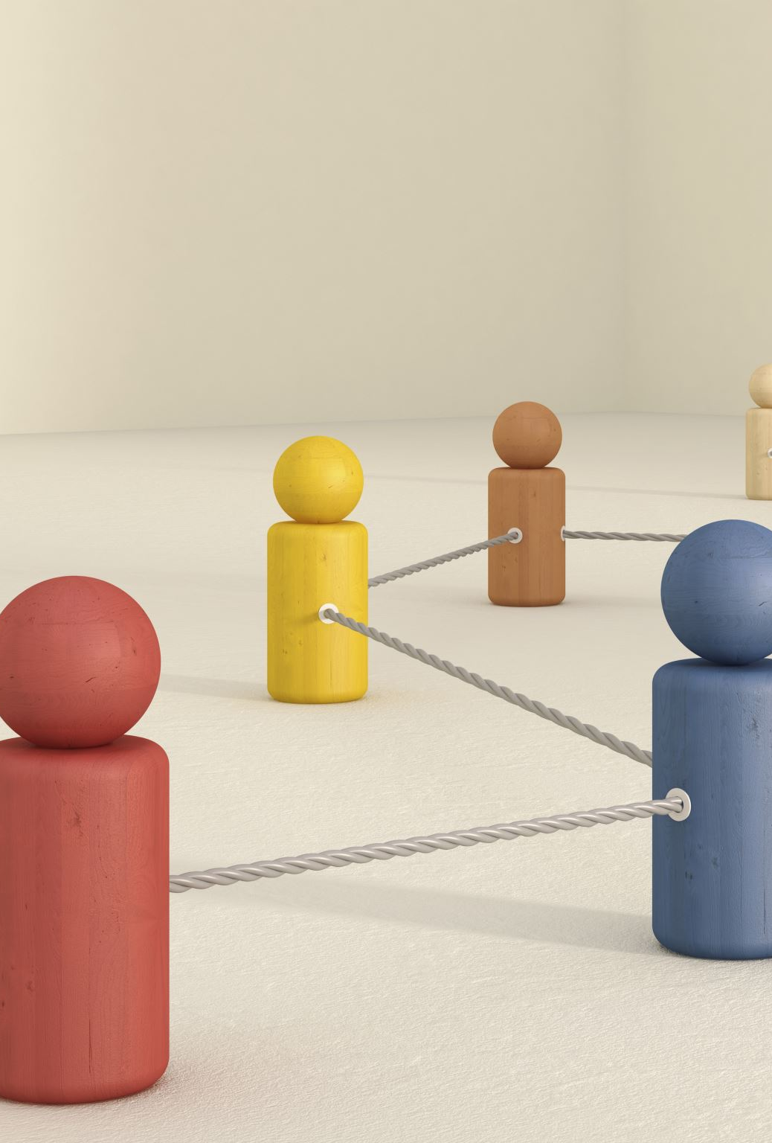
Motivation
Agents navigate dynamic phases: spinning vs. claiming
Designed to simulate:
Cooperative decision-making under pressure
Spatial negotiation and coordination
Emergent group formation strategies

Slide 3

Environment LAYOUT
Arena: Circular, bounded 2D space
arena_radius: Full boundary
center_radius: Core zone for "spinning phase"
Rooms: Evenly spaced along the perimeter
n_rooms: Number of rooms
room_radius: Area per room
room_capacity: Max agents per room

Slide 4
Phases
Spinning
Occasional rotation simulates social disorientation
Claiming
Agents navigate to rooms
Must claim spots within room capacity
Agents move in the center circle

Slide 5

Agent Observations
Distance and direction to center
Nearest room's distance, direction, and occupancy
Nearest agent’s distance & direction
Phase indicator (binary flag)

Slide 6
REWARDS
Activated per phase: "spinning", "claiming", or "both".
02
Dynamically toggled via .active flag.
03
All reward logic inherits from a base RewardModule.
01

Slide 7
REWARDS
CloseToCenterReward
Move closer to arena center
InsideCenterReward
Stay inside center (reward/penalty)
CollisionAvoidance
Maintain safe distance from others
GetToRoomReward
Approach nearest available room
StayInRoomReward
Remain in non-overfilled room

Slide 8
REWARD MANAGER
Manages progressive activation of reward modules during training.
Enables curriculum-style reward shaping based on agent performance.

Slide 9
METRICS
CollisionRateMetric
Ratio of agent pairs too close together
RoomOccupancyRateMetric
Fraction of agents inside defined room areas
CenterPresenceMetric
Time agents spend near the environment center
AverageStepDistanceMetric
Mean distance moved per step
IdleAgentRateMetric
Fraction of agents barely moving across steps
RoomSwitchesMetric
How often agents switch closest room target
PhaseTimeMetric
Proportion of time spent in each environment phase
AgentDensityMetric
Average number of neighbors within a fixed radius
MaxDistanceFromCenterMetric
Maximum distance an agent reaches from center
MinAgentDistanceMetric
Minimum distance recorded between any two agents
AverageRoomDistanceMetric
Mean distance from agents to nearest room
AgentMovementVarianceMetric
Variance in agent movement magnitudes over time

Slide 10
Training components
Custom Env via make_env()
With optional RewardManager & RewardModule
ObservationNorm

Slide 11
Training components
Data Flow
Collector: SyncDataCollector
Gathers batches from env
Replay Buffer: LazyTensorStorage
Sampling with SamplerWithoutReplacement

Slide 12
tRAINING COMPONENTS
Learning Modules
Advantage Estimation:
StableGAE
(Generalized Advantage Estimation)
Loss:
ClipPPOLoss (with entropy bonus)

Slide 13
COMPLICATIONS
tensor(0.2243, device='cuda:0', grad_fn=<SqueezeBackward1>)
tensor(109.6843, device='cuda:0', grad_fn=<AddBackward0>)
tensor(0.2578, device='cuda:0', grad_fn=<SqueezeBackward1>)
tensor(101.8417, device='cuda:0', grad_fn=<AddBackward0>)
tensor(0.3262, device='cuda:0', grad_fn=<SqueezeBackward1>)
tensor(108.4116, device='cuda:0', grad_fn=<AddBackward0>)
tensor(inf, device='cuda:0', grad_fn=<SqueezeBackward1>)
tensor(inf, device='cuda:0', grad_fn=<AddBackward0>)
tensor(nan, device='cuda:0', grad_fn=<SqueezeBackward1>)
tensor(nan, device='cuda:0', grad_fn=<AddBackward0>)
tensor(nan, device='cuda:0', grad_fn=<SqueezeBackward1>)
tensor(nan, device='cuda:0', grad_fn=<AddBackward0>)
tensor(nan, device='cuda:0', grad_fn=<SqueezeBackward1>)
tensor(nan, device='cuda:0', grad_fn=<AddBackward0>)
tensor(nan, device='cuda:0', grad_fn=<SqueezeBackward1>)
tensor(nan, device='cuda:0', grad_fn=<AddBackward0>)
tensor(nan, device='cuda:0', grad_fn=<SqueezeBackward1>)

Slide 14
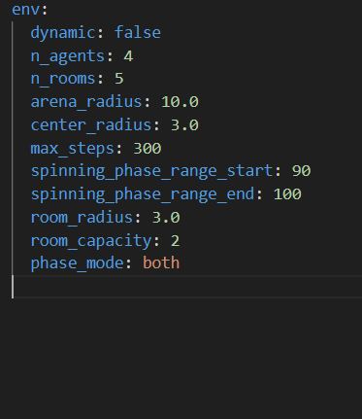
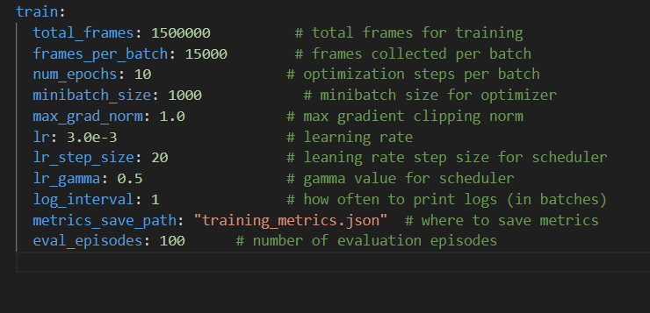
Yet another markup language

Slide 15
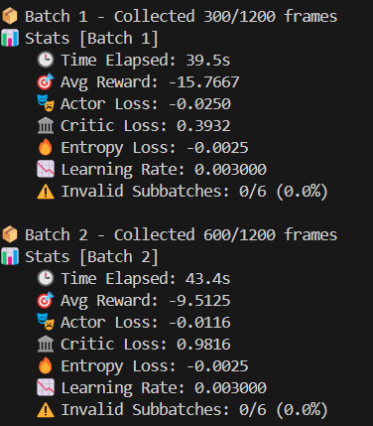
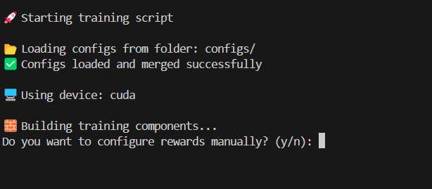
LOGGING

Slide 16
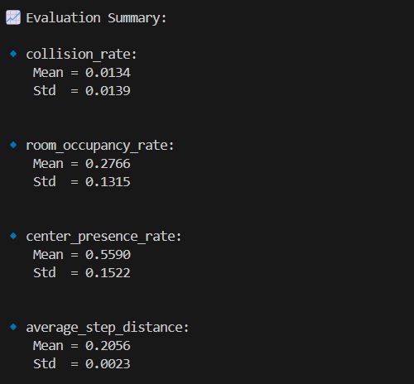
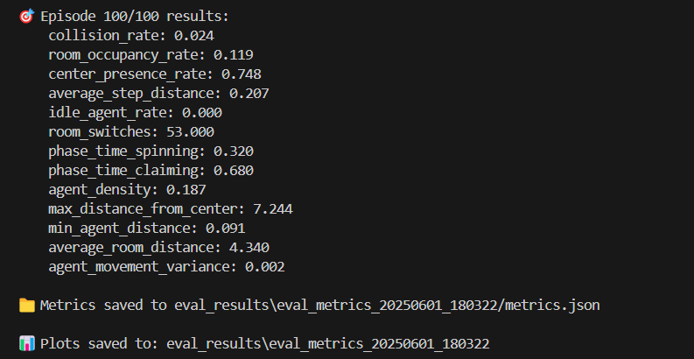
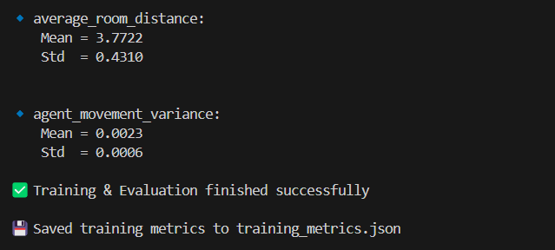
LOGGING

Slide 17
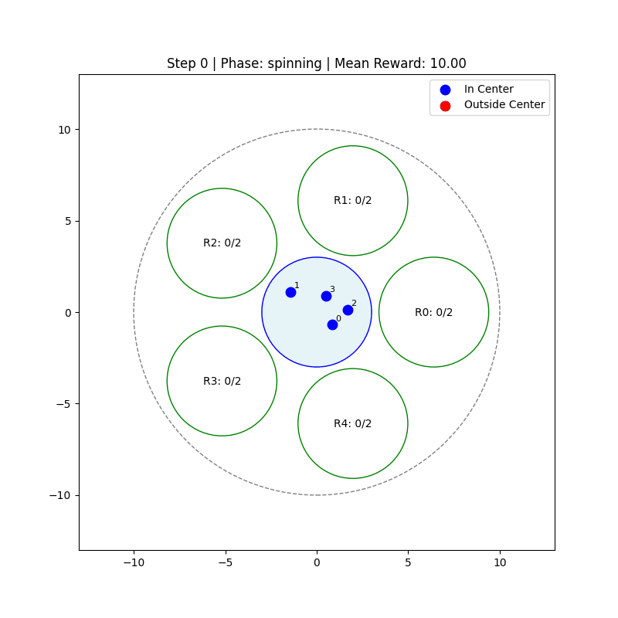
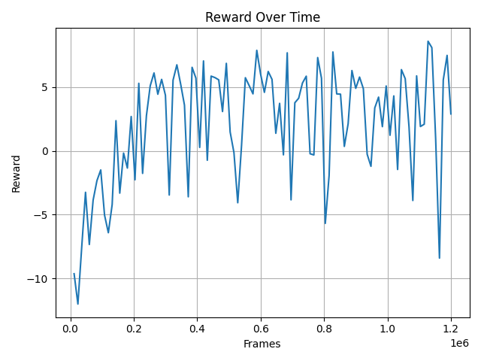
RESULTS

Slide 18
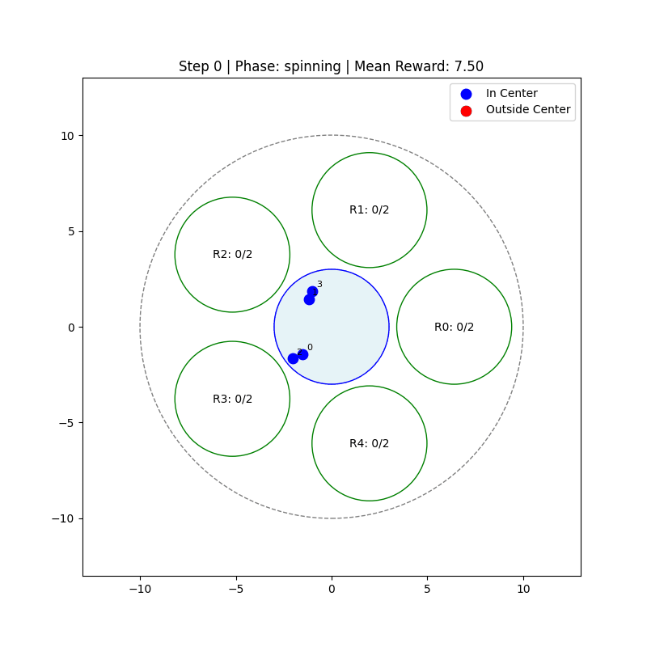
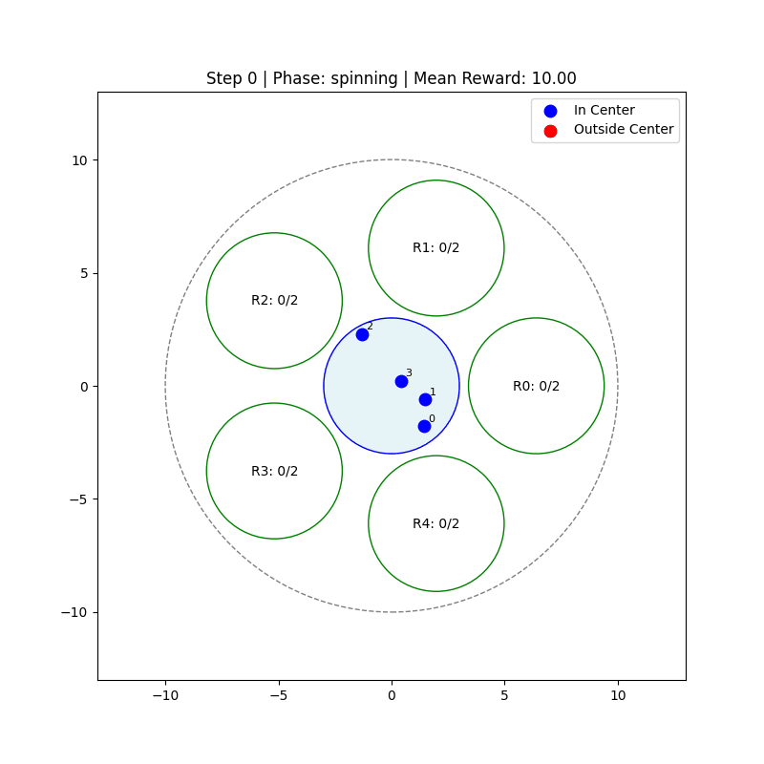
results

Slide 19
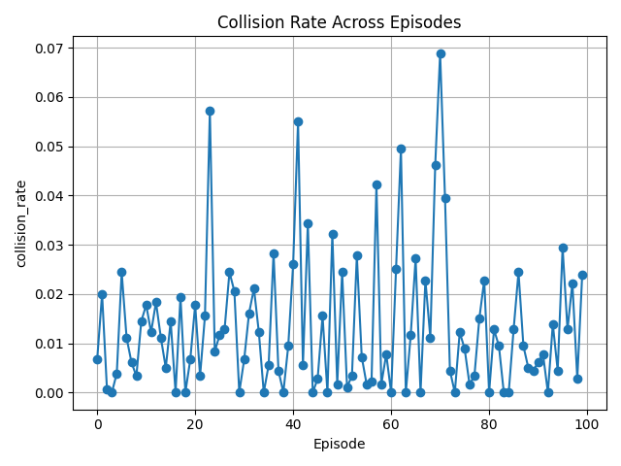
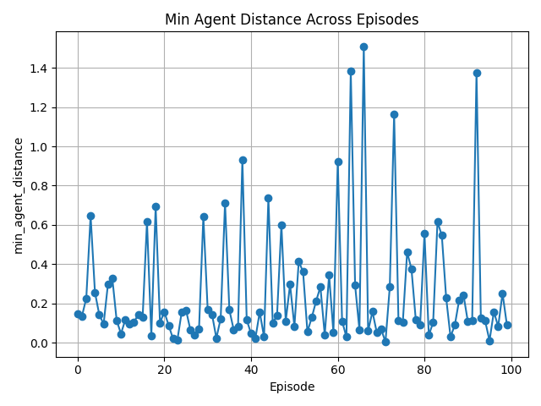
results

Slide 20
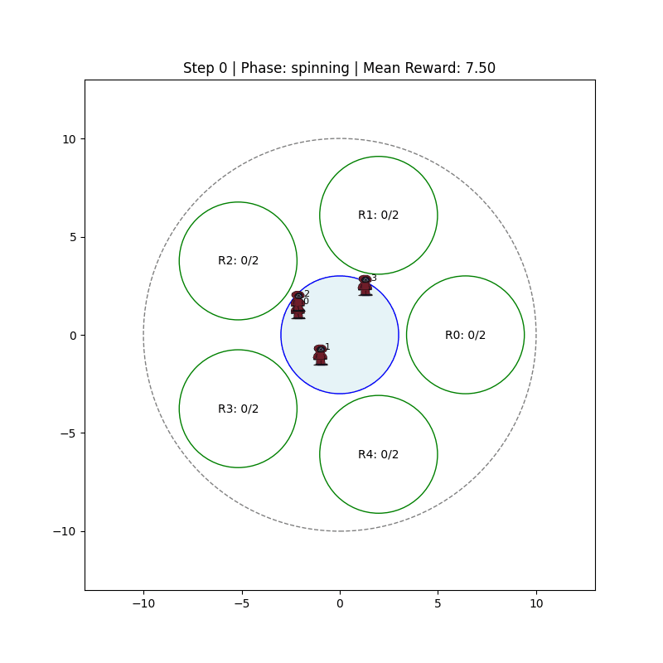
Future directions

